Slide 1
Prof. Rajinder Kumar
1934 - 2022

Slide 2
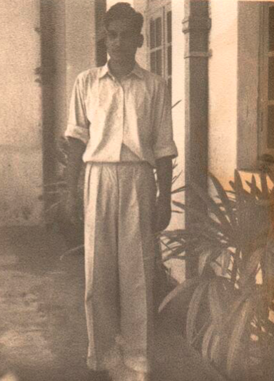
The earliest photo with us, perhaps late 1950's at IISc.

Slide 3

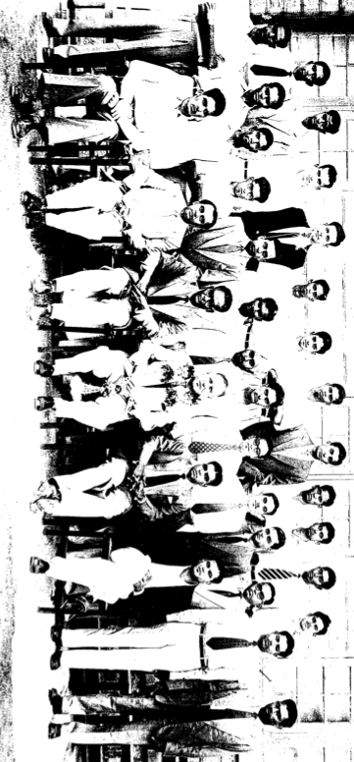
Joined
IISc
R K Sharma
Renounced “Sharma”
To protest against
Casteism and
Became
R. Kumar

Slide 4
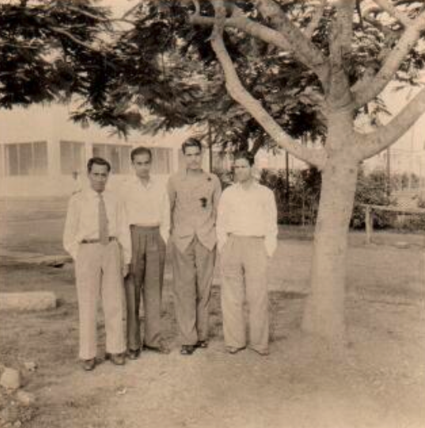

The early days…
R Kumar, supervisor R L Dutta (on left). The other supervisor Prof. Weingaertner.

Slide 5
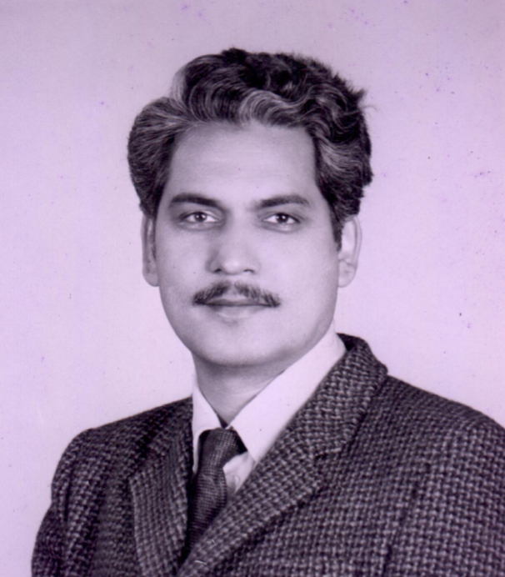
Prince of Punjab
"Prince of Punjab",
the name by
Prof. D. Ramkrishna
Purdue University.

Slide 6
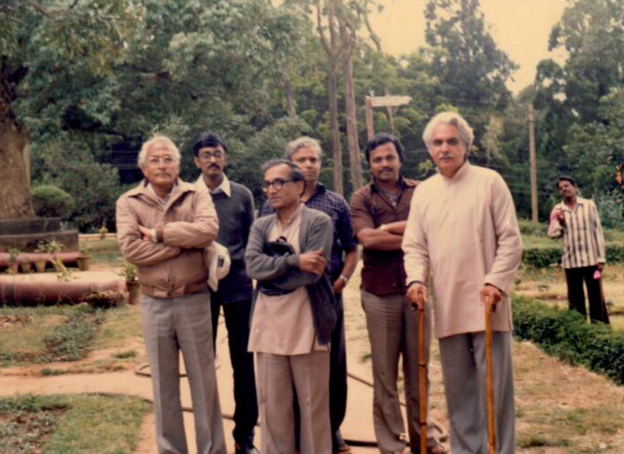
Nothing ever came in his way
Moving around with colleagues with two sticks in hands but unfazed!

Slide 7
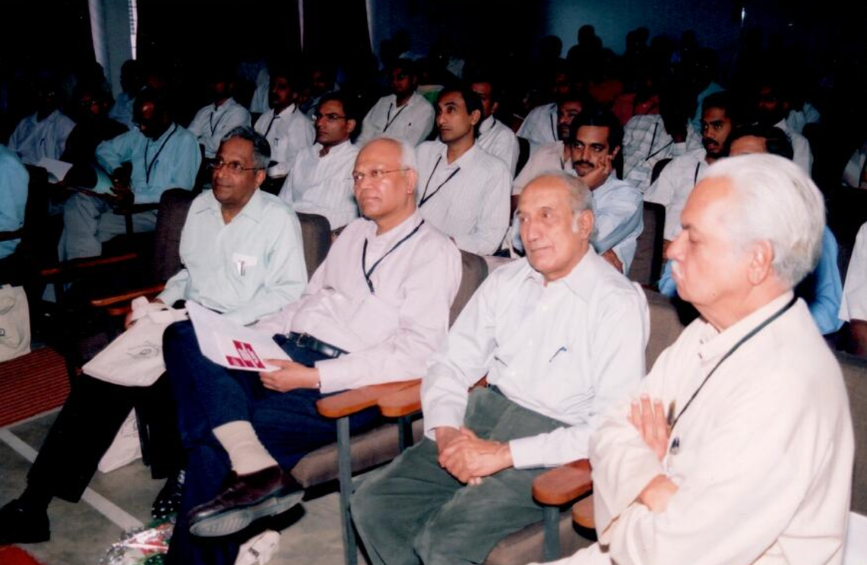
A picture worth millions..
A group of people with warmth, affection, and mutual respect for each other's contributions. A rarity today, but something that came naturally to Prof. Kumar. He developed collaborations around problems in need of complementary skills, not problems to sustain/support collaborations.
Prof. D. Ramkrishna, Dr. Mashelkar, Prof. Krishnan, and Prof. Kumar

Slide 8
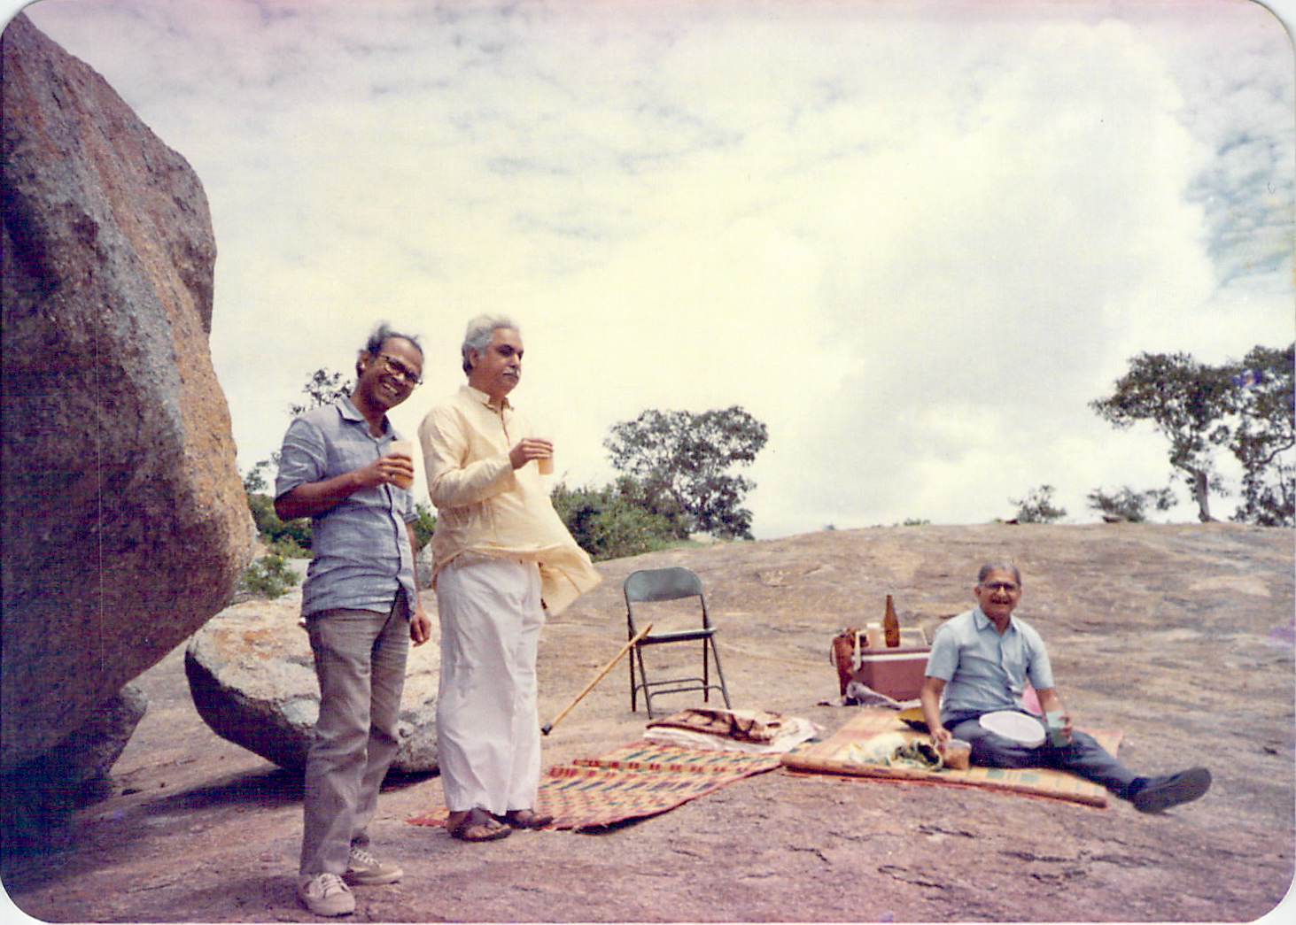
The Most Famous Trio Of The Department
They, among other things, led to installation of ten lakh smokeless wood stoves in rural Karnataka.
S.S Lokras, R.Kumar, and K.S Gandhi

Slide 9
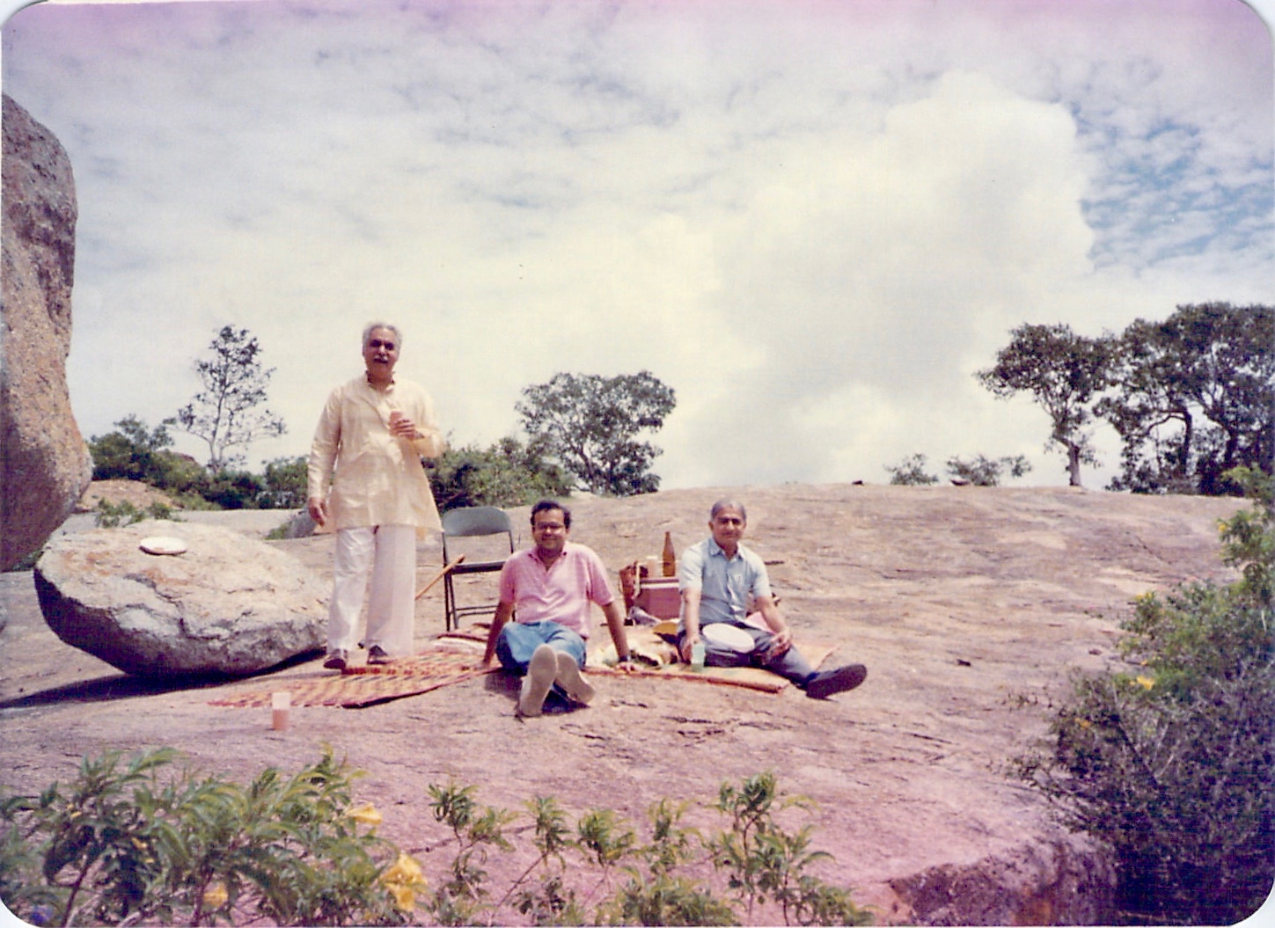
Amidst the Cool Breeze of Nandi Hills,
Nurturing and Nourishing New faculty
Initiation of new faculty to good things in life … in cool air of Nandi hills.
These subtle moves allowed new faculty to mix with the old faculty and the existing students effortlessly.

Slide 10
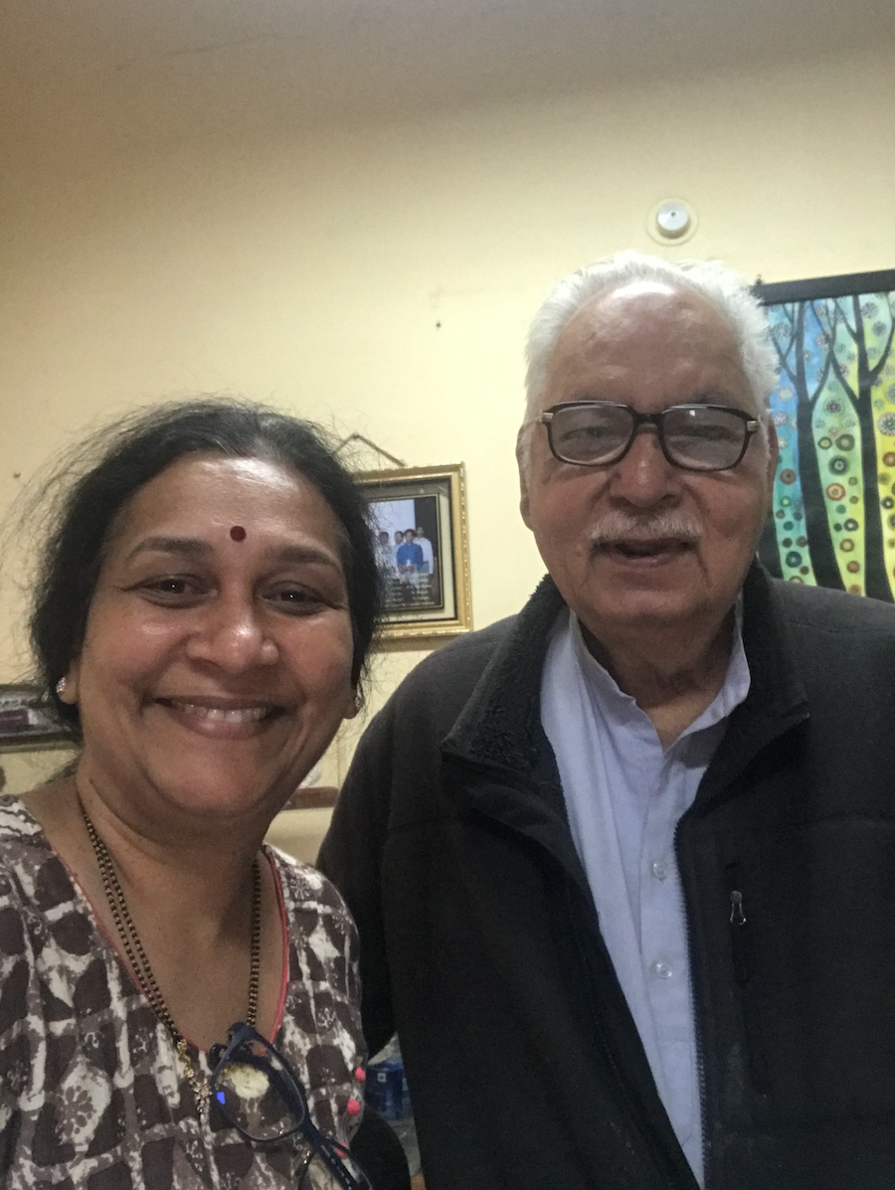
The Surprise Visits By His fos former students
first alone, then with spouse, and then with children continued all along

Slide 11
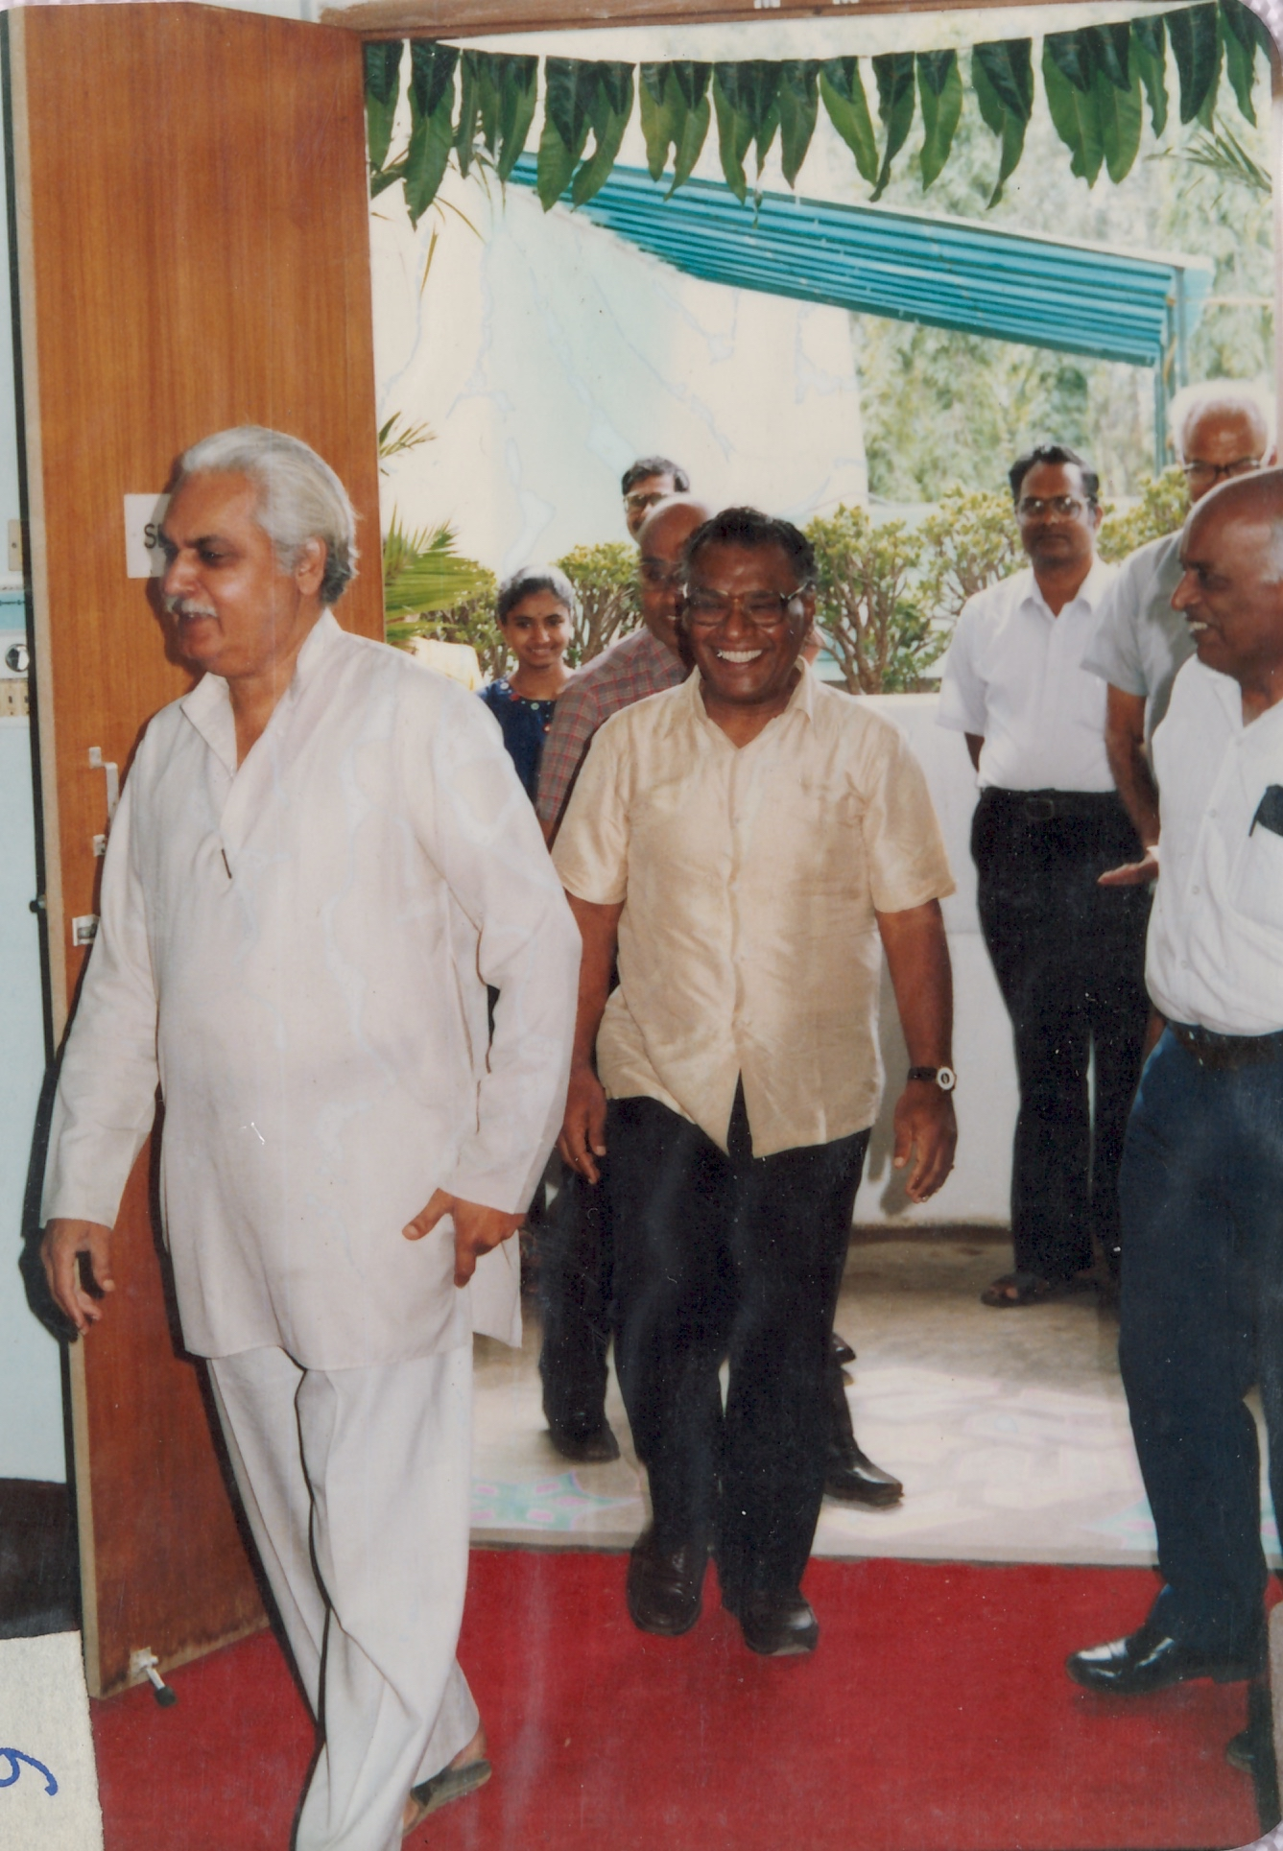
Inauguration of Indo-US Seminar on Chemical Engineering
With Prof. CNR Rao (Director) and
Prof. A Sridharan (deputy Director)

Slide 12
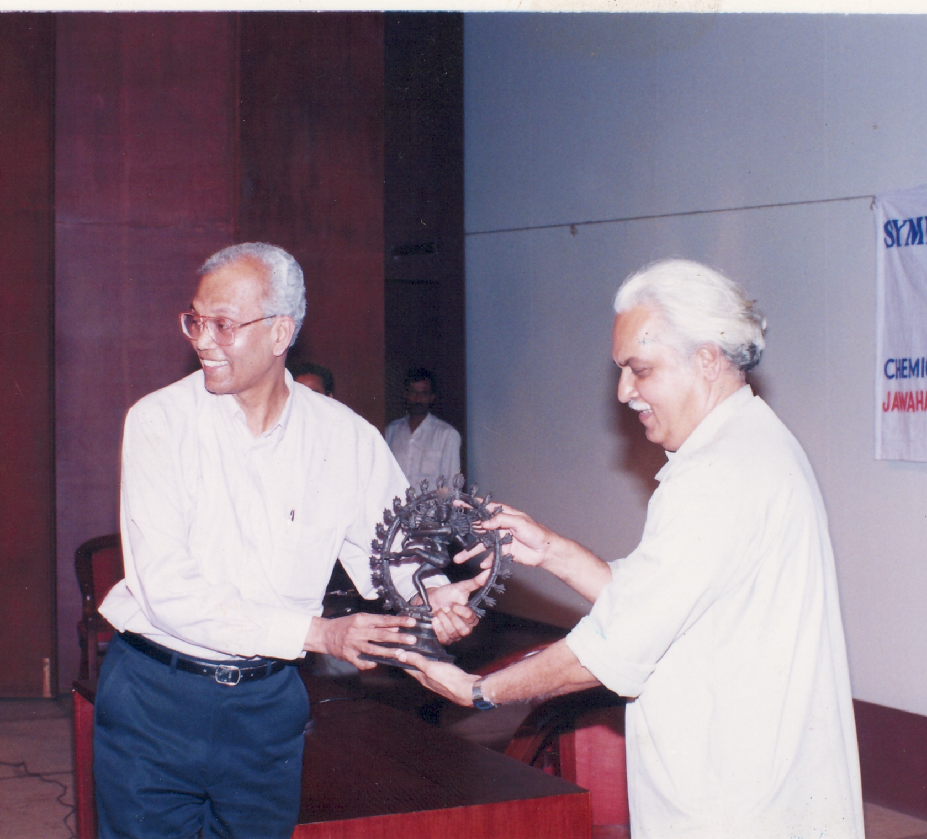
Two men who rose from humble beginnings …
… today inspire generations of students to work hard and gather courage to pose and tackle what appears to be impossible to achieve.

Slide 13
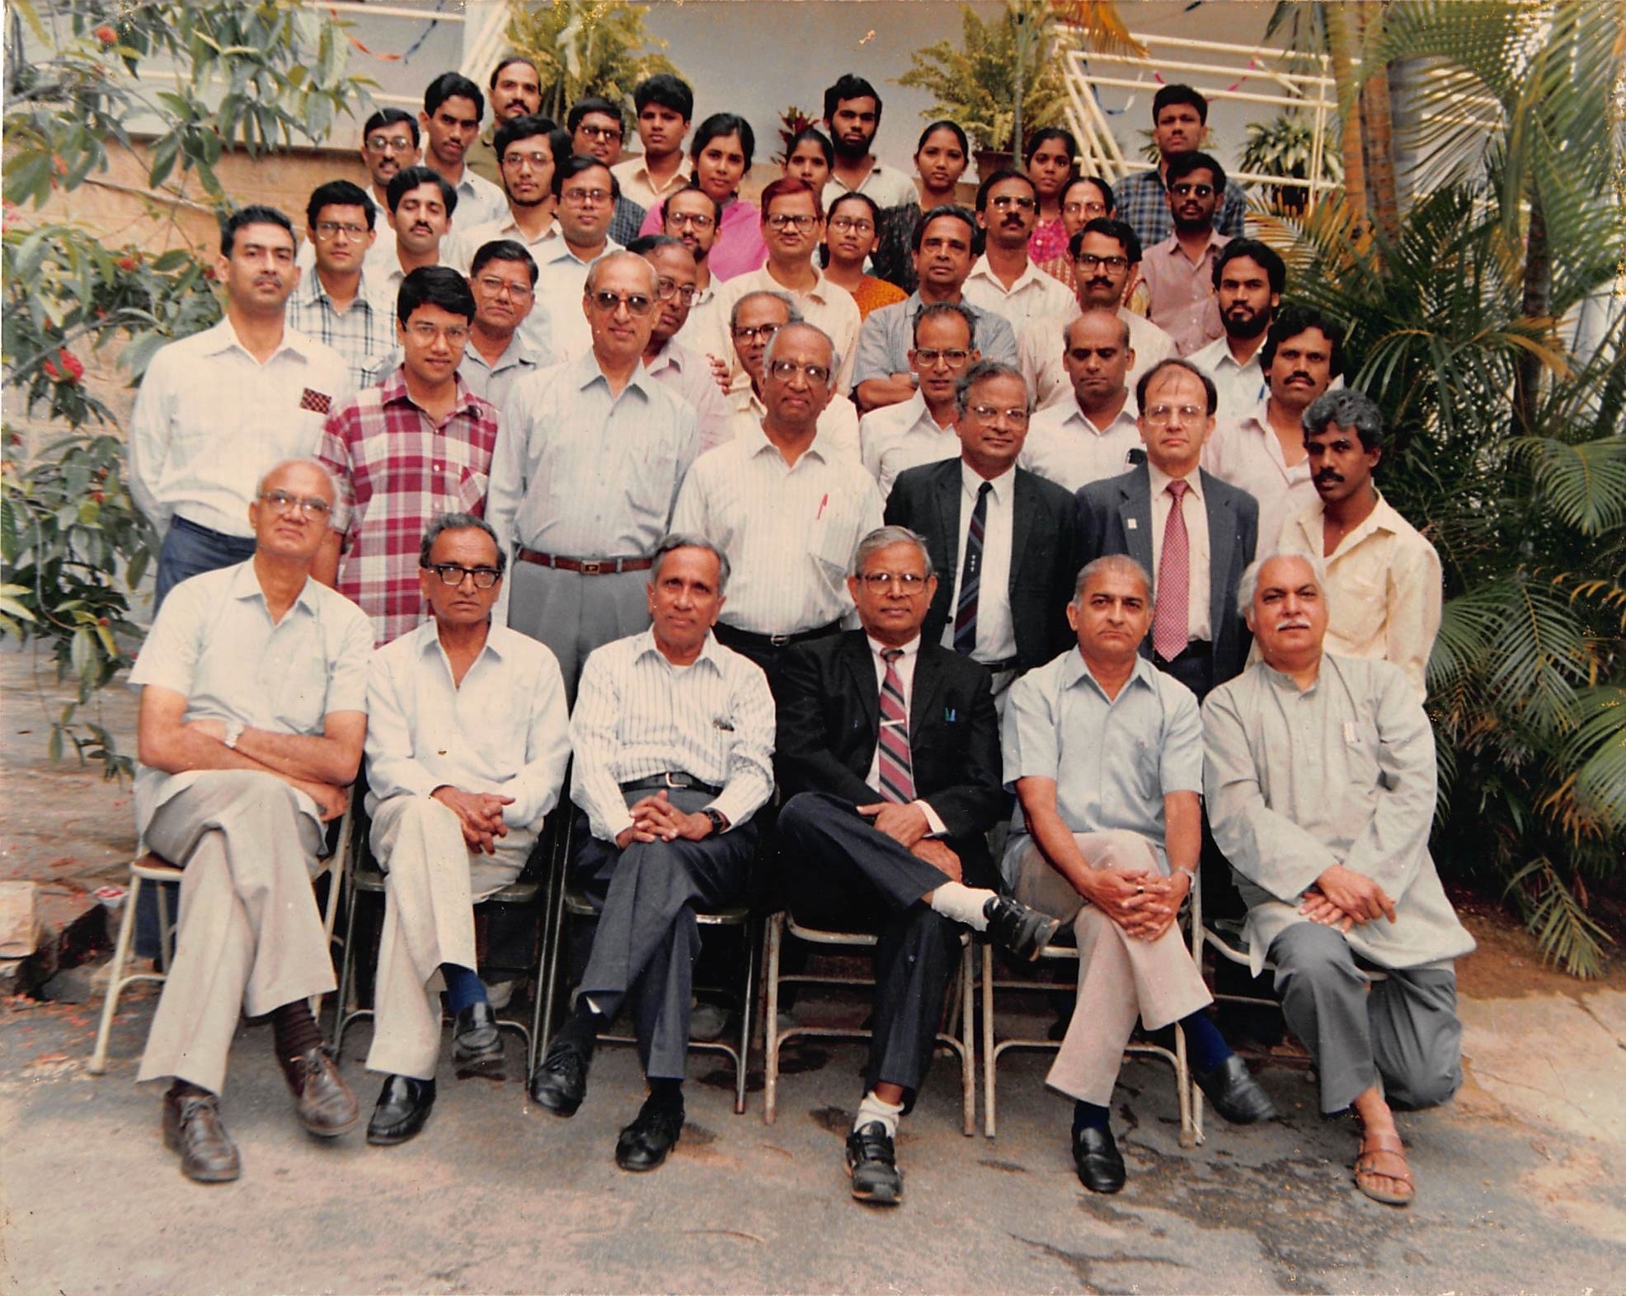
Prof. Kumar and Colleagues in early 90's

Slide 14
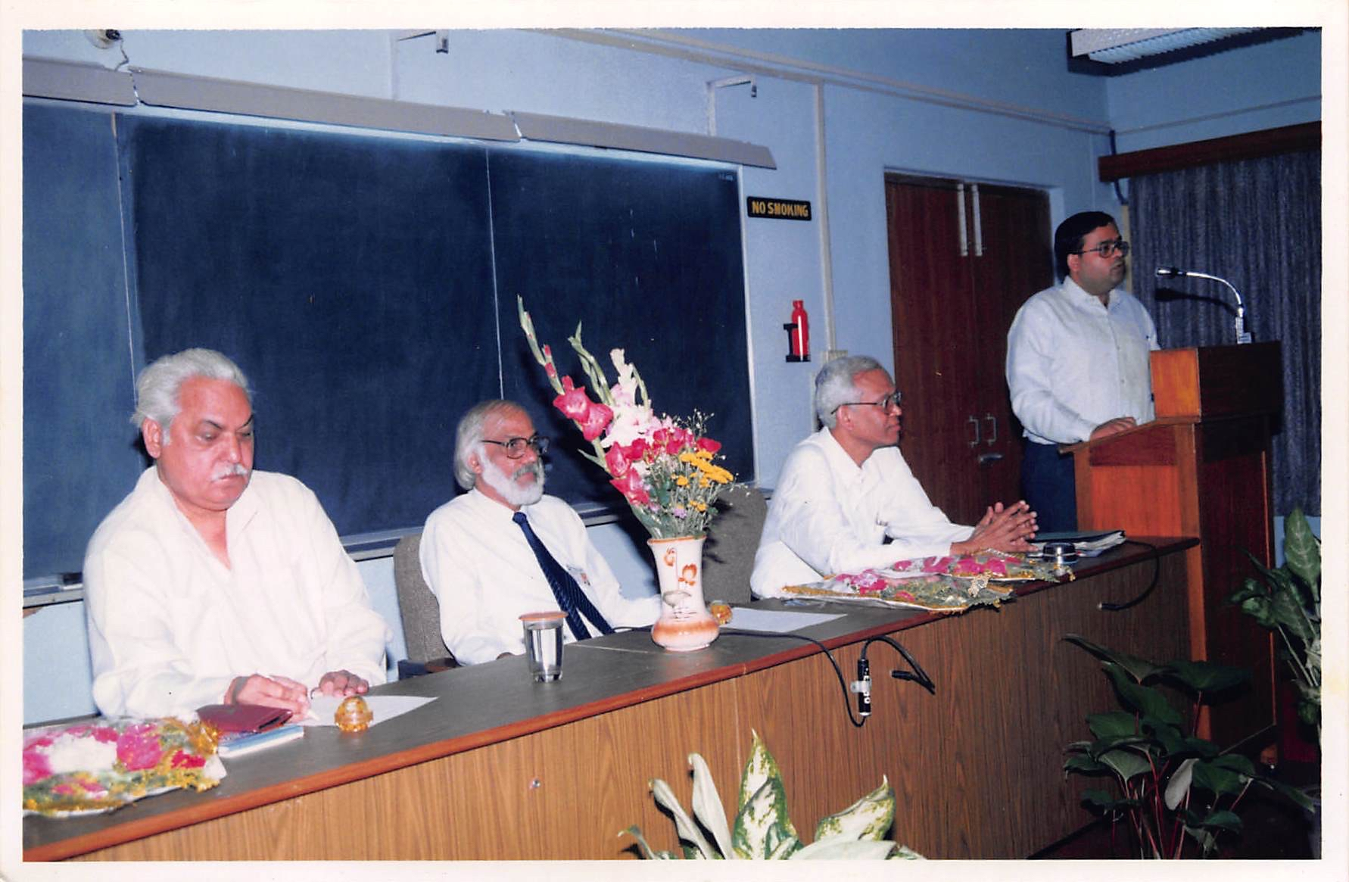
Three Padma awardees and very young Prof. Jayant Modak

Slide 15
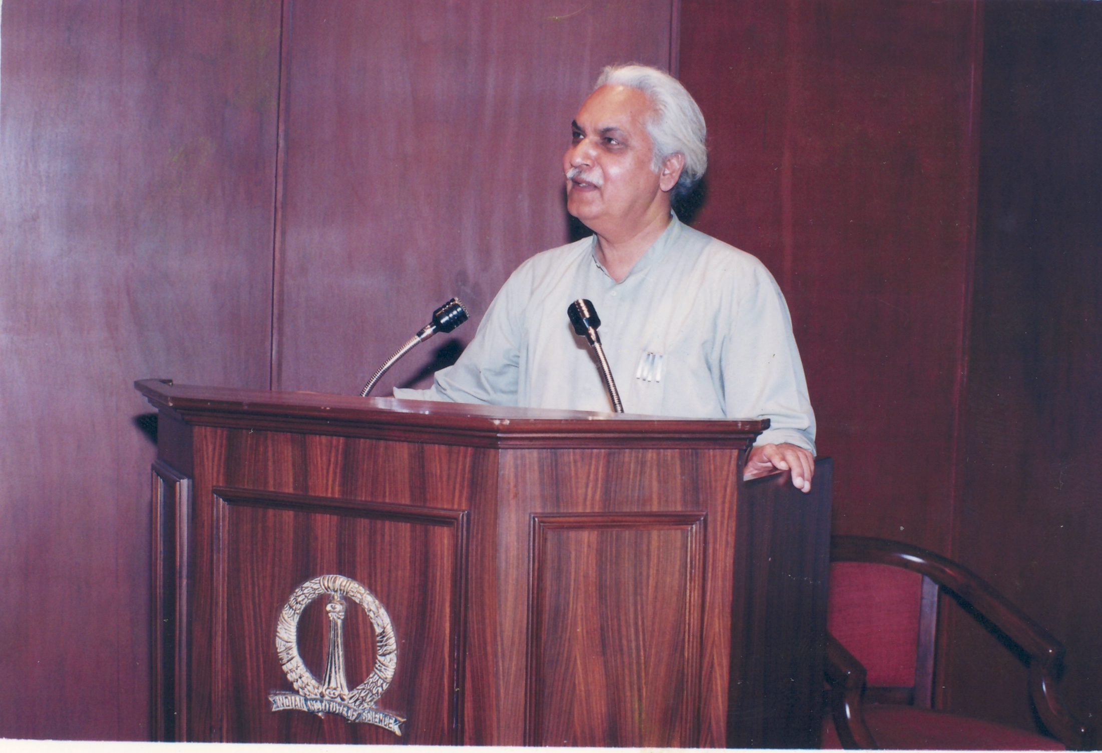
Not A Word Unplanned, Yet Spontaneous!
These lectures, always delivered to a hall filled with audience, demanded enormous effort to prepare and deliver, but Prof. Kumar always set a new benchmark for preparation and delivery.
Not a word he would say would be unplanned and yet these lectures appeared to be spontaneous speeches.

Slide 16
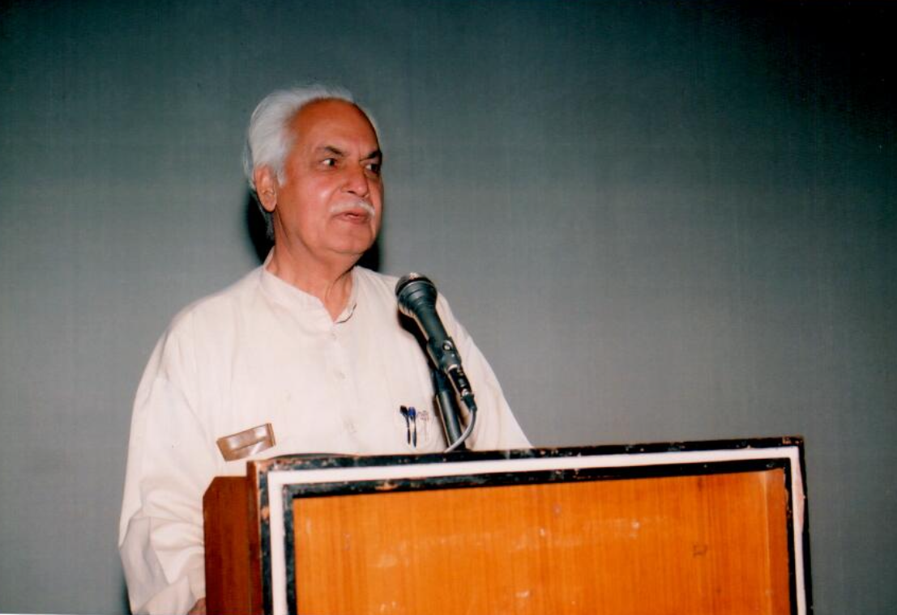
An
Unmatched
Orator

Slide 17
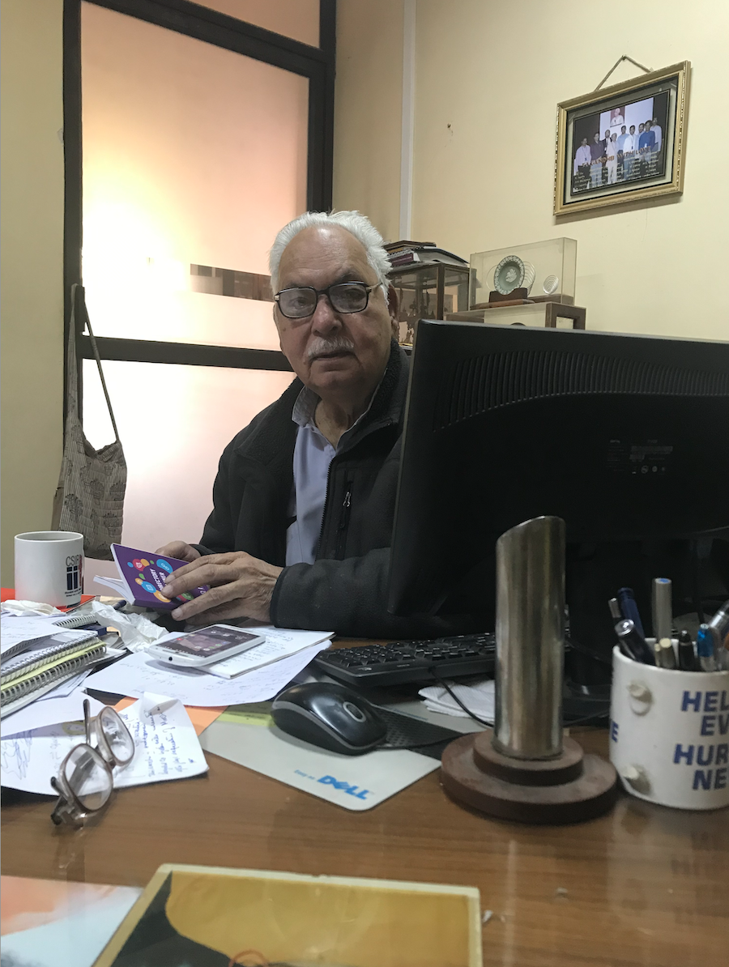
The Occupied Desk
Prof. Kumar was always sought after by a number of organizations, including CSIR, CHT.
This picture which shows him as busy as one can be, is taken after he was well past his honorary professor phase at the Institute.

Slide 18
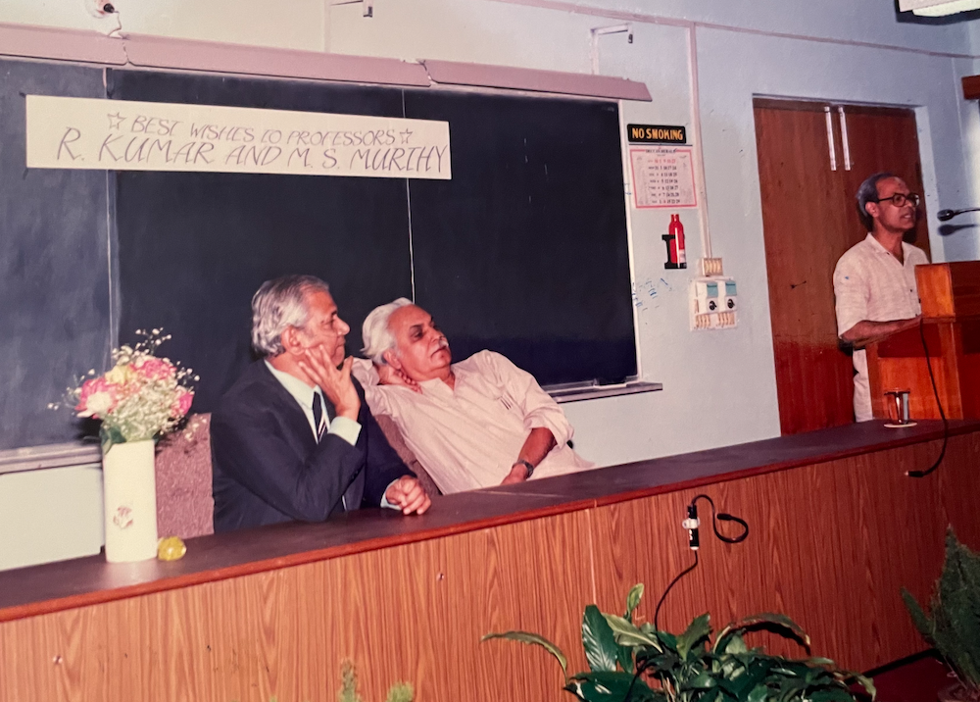
Retirement Felicitation Function
In a felicitation function on the occasion of his formal retirement along another colleague (Prof. M. S. Murthy)
Prof. Kumar continued as an Honorary professor of the institute, and a Honorary Professor at JNCASR.

Slide 19
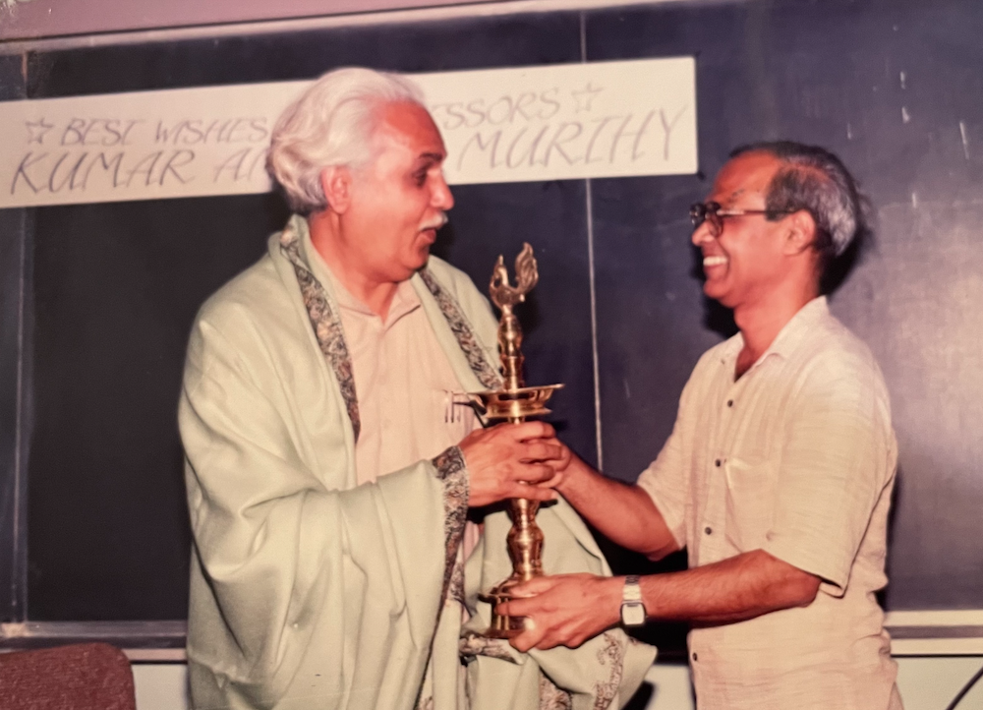
Their respect and admiration for each other will become folklore

Slide 20
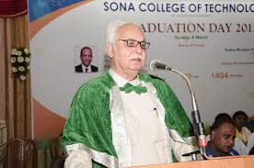
Graduation Day at SONA College of Technology
His affiliation with SONA group of institutions goes back more than five decades.
“…He used to give many innovative and thought provoking ideas and throw open many workable scientific problems….. Our group of institutions owes a lot to Prof. Kumar…”
- Dr. S.R.R. Senthilkumar

Slide 21
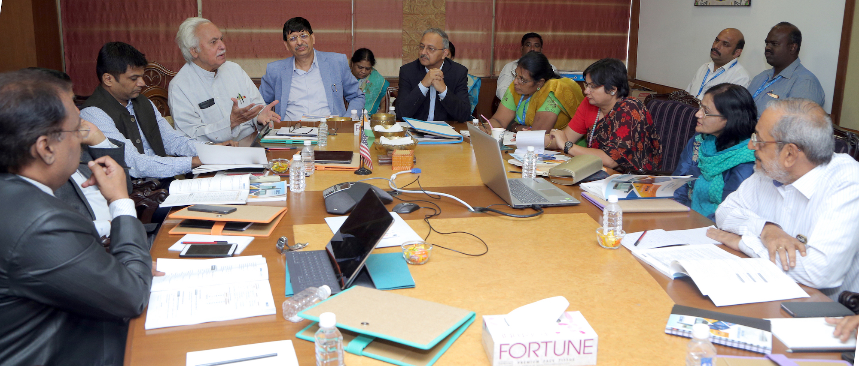
Rapt attention, wherever he spoke

Slide 22
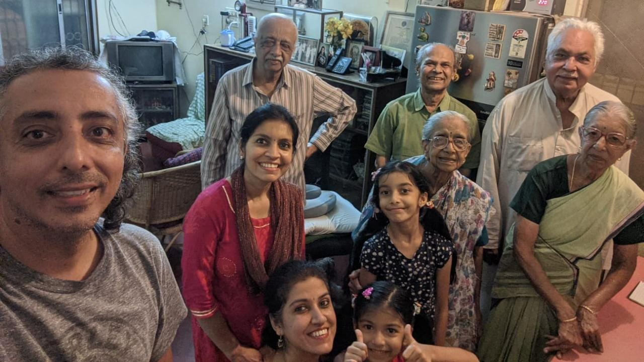
The Family
Son Arun, daughter-in-law Savita, granddaughter, mother-in-law, and Mrs Kumar
Brother-in-law and Gandhi ji

Slide 23
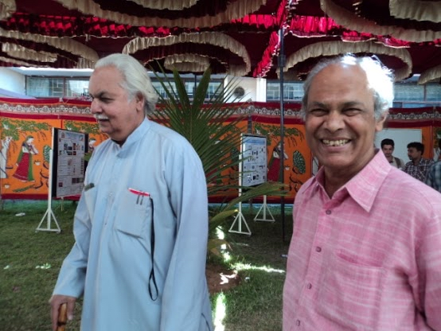
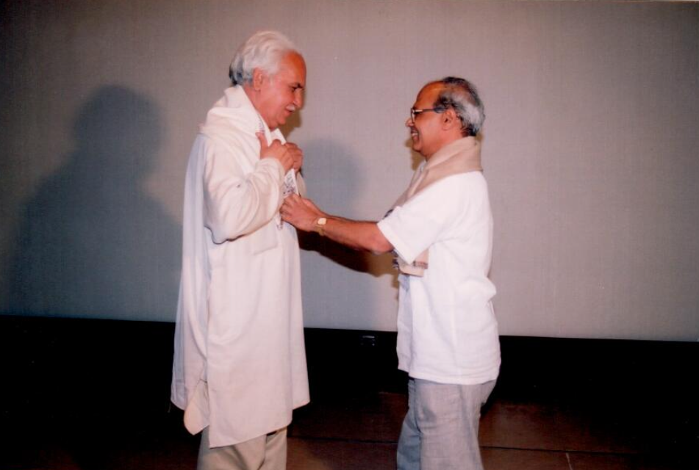
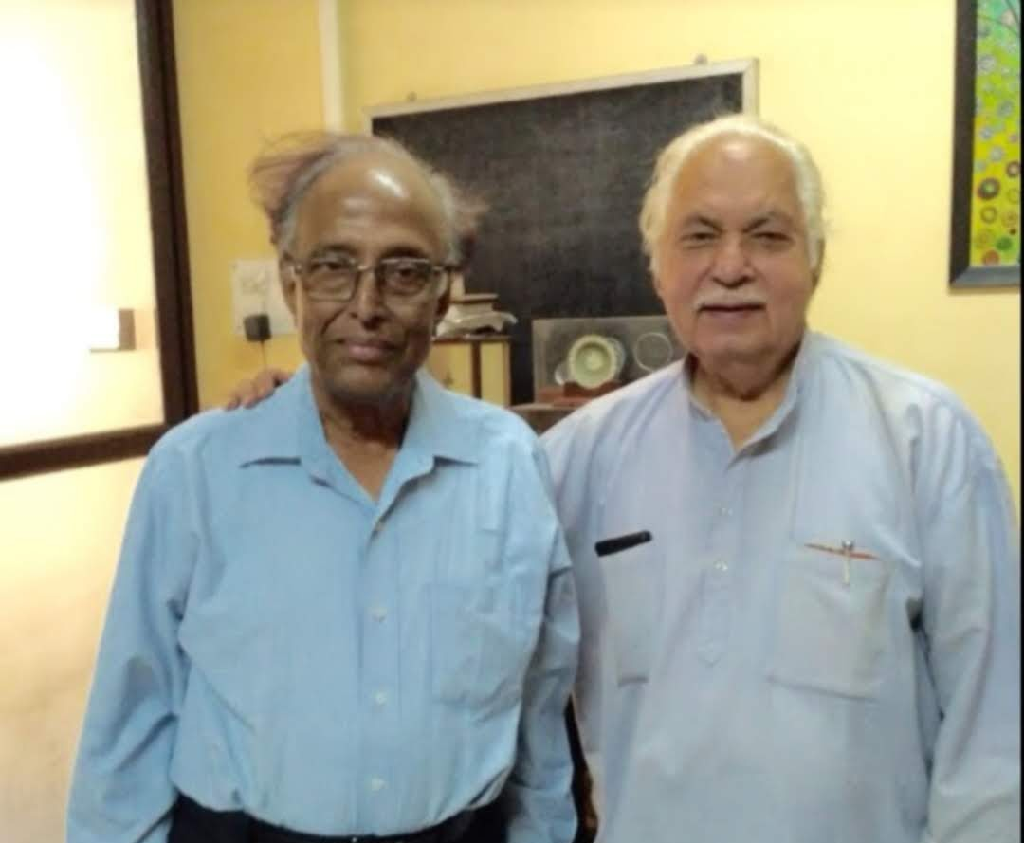
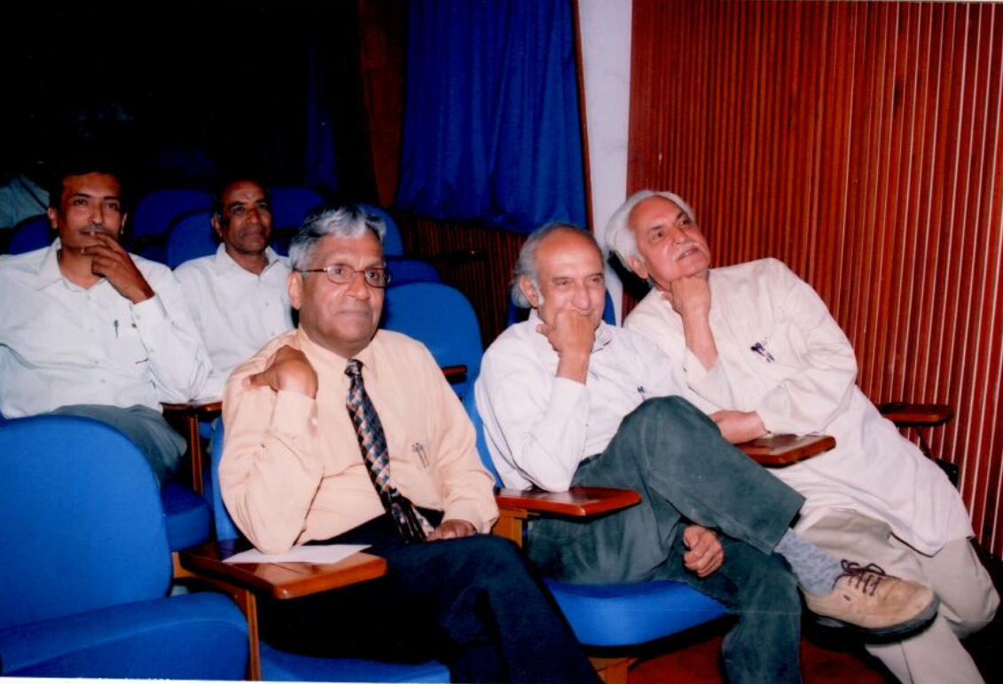
Fond
Memories
With Prof. Kumar

Slide 24
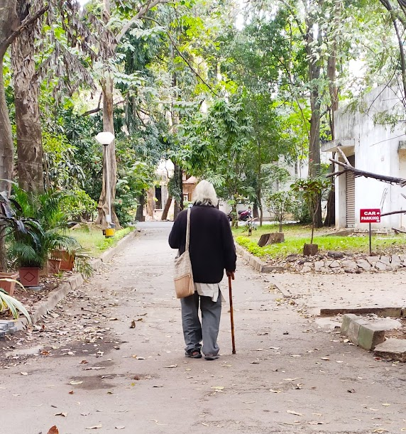
The Department You Nurtured, Guided, And Helped Rise
Will Be Forever Grateful To You.
You Will Be Missed …

Slide 29
The mutual respect and fondness between them setup a collaboration of the highest professional order – Made for each other and yet nothing common between them.
One driven by intuition which comes from a profound understanding of the core concepts and the courage to eliminate noise and distracting hypotheses and the other moving an inch only after backing it up at every stage with rigour and mathematics.
The end result: An unparalleled marriage of intuition, simplification, rigour, and analysis which led to impactful and creative work.
Kumar Gandhi Duo…

Slide 30
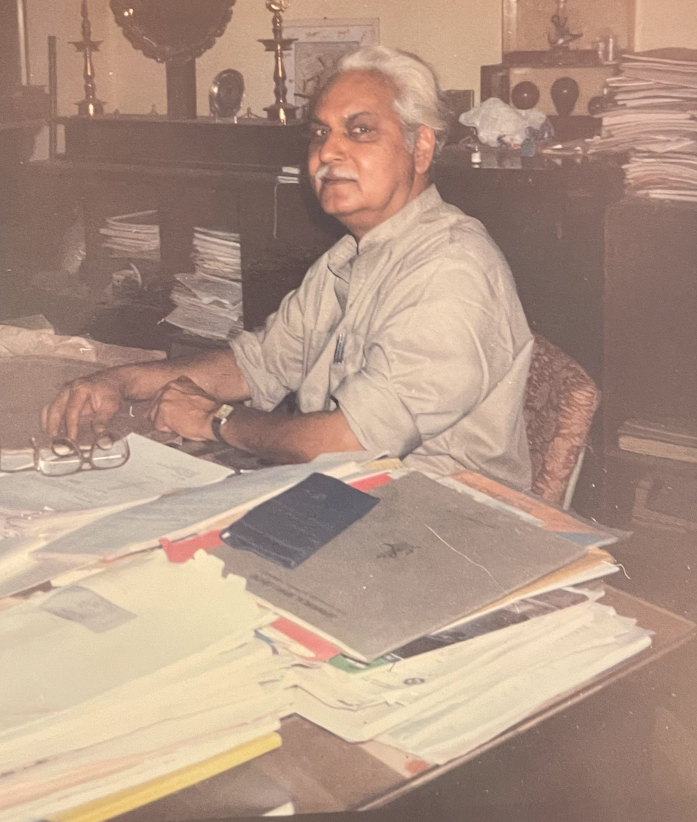
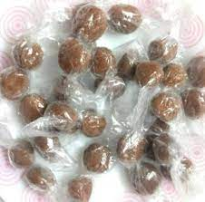
Out of the many of awards and fancy souvenir Prof. Kumar received, he only kept what student presented to him on his retirement (left) and 3D carving of his bubble formation model in wood. The rest came to students, except for one – His Padma Bhushan.
He was known to Indian Airlines air hostess as one who took the largest number of tamrind (imli) candy to be distributed to students. So they started offering him many more whenever he was on board!

Slide 31
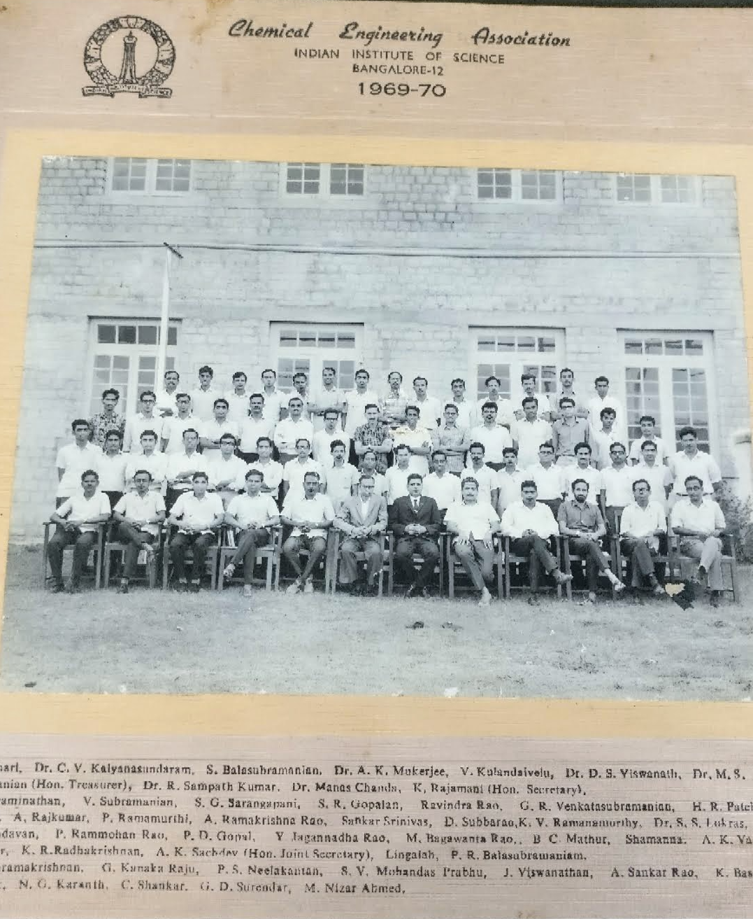
Chemical Engineering Association (1969-70)
The person on the left of the black-suit is Prof. R. Kumar, named as Prof Rajinder Kumar Sharma.
He dropped 'Sharma' protest against casteism. And became Prof. R. Kumar.

